Slide 1
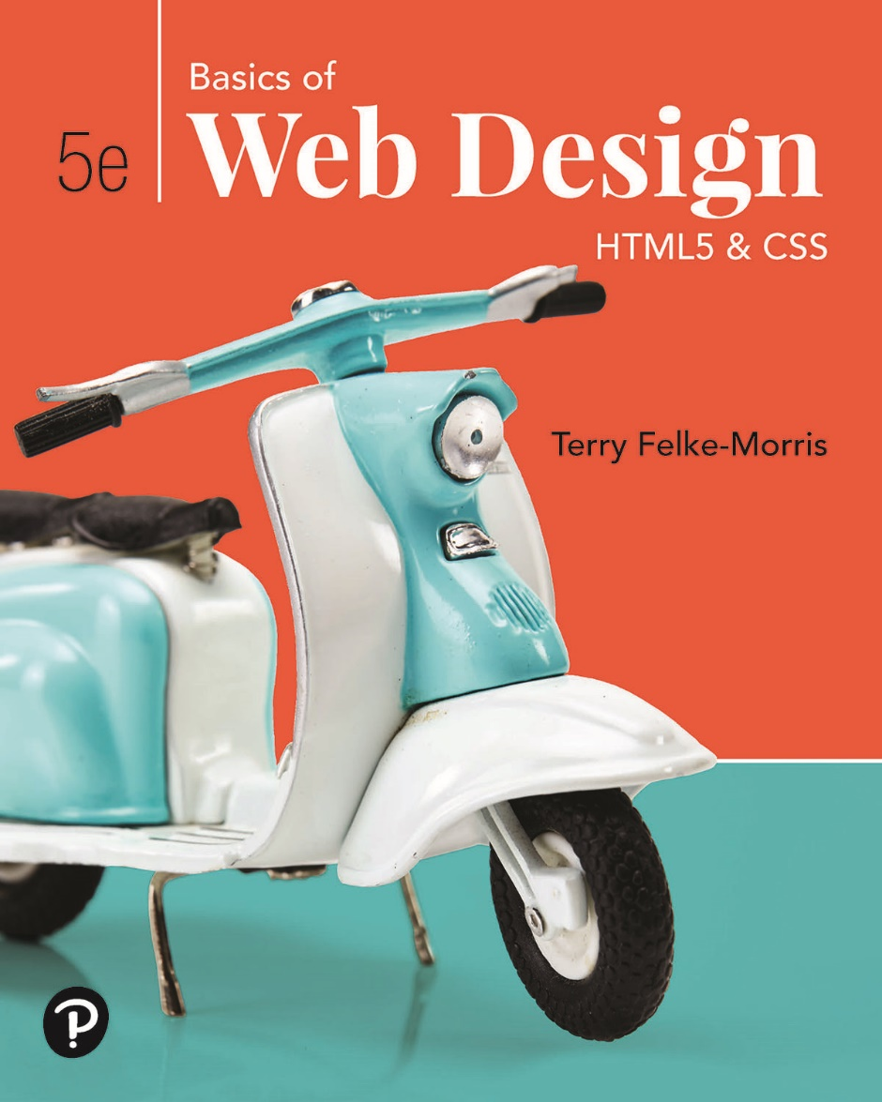
Basics of Web Design
Fifth Edition
Chapter 9
Table Basics Key Concepts
Copyright © 2025 Pearson Education, Inc. All Rights Reserved
Notes:
If this PowerPoint presentation contains mathematical equations, you may need to check that your computer has the following installed:
1) Math Type Plugin
2) Math Player (free versions available)
3) NVDA Reader (free versions available)

Slide 2
Learning Outcomes
Describe the recommended use of a table on a web page
Configure a basic table with the table, table row, table header, and table cell elements.
Configure a table to provide for accessibility
Use C S S to style an H T M L table
Describe the purpose of C S S 3 structural pseudo-classes

Slide 3
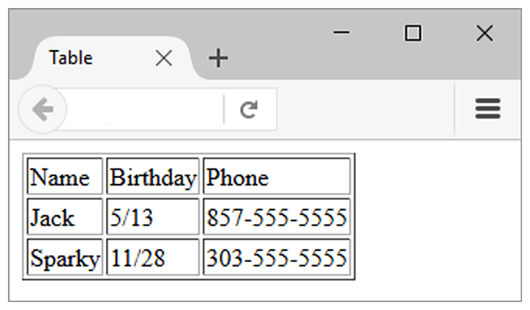
H T M L Table
Tables are used on web pages to organize tabular information
Composed of rows and columns – similar to a spreadsheet.
Each individual table cell is at the intersection of a specific row and column.
Configured with table, tr, and td elements

Slide 4
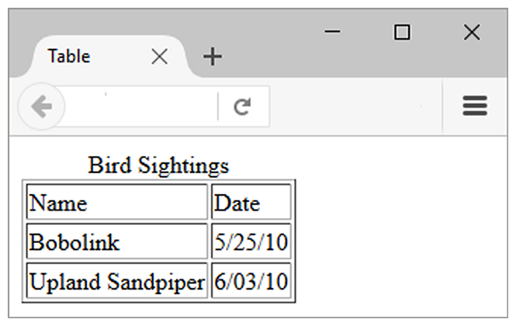
H T M L Table Elements
<table>
Contains the table elements
<tr>
Table row used to group set of related data cells
<td>
Table data is used to define a table data cell
<caption>
Configures a description of the table

Slide 5
The Table Element <table>
<tr> Element
Table Row It is a container element that holds one or more (td or th) elements, which represent the cells within the table row.
<td> Element
Table Data is container element that holds the content of the table cell.
<th> Element
Table Header is used to define a table header cell.
It is a container element that holds the content of a table header cell.

Slide 6
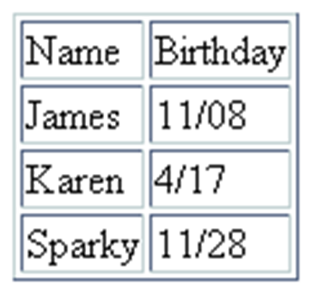
H T M L Table Example 1
<table border="1"> <caption>Birthday List</caption>
<tr>
<td>Name</td>
<td>Birthday</td>
</tr>
<tr>
<td>James</td>
<td>11/08</td>
</tr>
<tr>
<td>Karen</td>
<td>4/17</td>
</tr>
<tr>
<td>Sparky</td>
<td>11/28</td>
</tr>
</table>
Birthday List

Slide 7
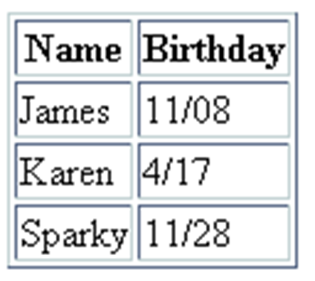
H T M L Table Example 2
<table border="1">
<tr>
<th>Name</th>
<th>Birthday</th>
</tr>
<tr>
<td>James</td>
<td>11/08</td>
</tr>
<tr>
<td>Karen</td>
<td>4/17</td>
</tr>
<tr>
<td>Sparky</td>
<td>11/28</td>
</tr>
</table>
Using the <th> Element

Slide 8
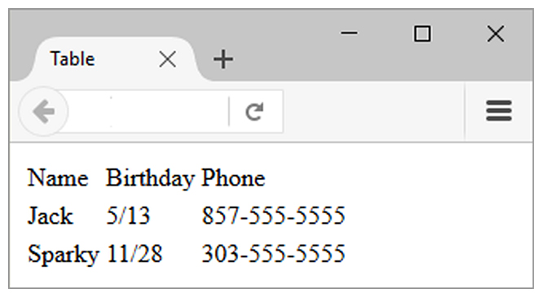
H T M L border Attribute
Indicates the table is specifically not used for page layout
Optional
border=“1”
Visible browser default border
border=“”
No visible browser default border

Slide 9
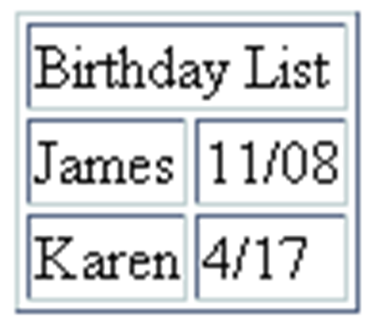
H T M L colspan Attribute
<table border="1">
<tr>
<td colspan=“2”> Birthday List</td>
</tr>
<tr>
<td>James</td>
<td>11/08</td>
</tr>
<tr>
<td>Karen</td>
<td>4/17</td>
</tr>
</table>

Slide 10
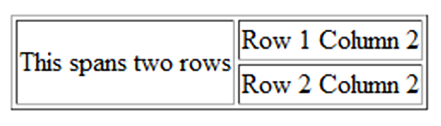
H T M L rowspan Attribute
<table border="1"> <tr> <td rowspan="2">This spans two rows</td> <td>Row 1 Column 2</td> </tr> <tr> <td>Row 2 Column 2</td> </tr> </table>

Slide 11
Accessibility and Tables
Use table header elements (<th> tags) to indicate column or row headings.
Use the summary attribute on the table element to provide an overview of the purpose and organization of the table.
Use the caption element to provide the title/caption for the table.
Other attributes that provide for accessibility:
headers & id
scope

Slide 12
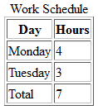
Accessibility: headers & id Attributes
<table>
<caption> Word Schedule</caption>
<tr>
<th id="day">Day</th>
<th id="hours">Hours</th>
</tr>
<tr>
<td headers="day">Monday</td>
<td headers="hours">4</td>
</tr>
<tr>
<td headers="day">Tuesday</td>
<td headers="hours">3</td>
</tr>
<tr>
<td headers="day">Total</td>
<td headers="hours">7</td>
</tr>
</table>

Slide 13
Using C S S to Style a Table
H T M L Attribute | C S S Property
align | Align a table: table { width: 75%; margin: auto; } Align within a table cell: text-align
bgcolor | background-color
cellpadding | padding
cellspacing | border-spacing or border-collapse
height | height
valign | vertical-align
width | width
border | border, border-style, or border-spacing
--- | background-image
--- | caption-side

Slide 14
C S S 3 Structural Pseudo-classes
Pseudo-class | Purpose
:first-of-type | Applies to the first element of the specified type.
:first-child | Applies to the first child of an element. (C S S 2 selector)
:last-of-type | Applies to the last element of the specified type.
:last-child | Applies to the last child of an element
:nth-of-type(n) | Applies to the “nth” element of the specified type. Values: a number, odd, or even

Slide 15
Summary
This chapter introduced coding techniques to create and configure tables.
You will find these skills useful as you create web pages.

Slide 16

Copyright
This work is protected by United States copyright laws and is provided solely for the use of instructors in teaching their courses and assessing student learning. Dissemination or sale of any part of this work (including on the World Wide Web) will destroy the integrity of the work and is not permitted. The work and materials from it should never be made available to students except by instructors using the accompanying text in their classes. All recipients of this work are expected to abide by these restrictions and to honor the intended pedagogical purposes and the needs of other instructors who rely on these materials.

